Slide 1
Some Design Patterns
In nutshell
Alex Beyderman
Software developer

Slide 2
Design Pattern are:
Template for how to solve a problem or implement an idea in source code.
Generally reusable solution of a common problem.

Slide 3
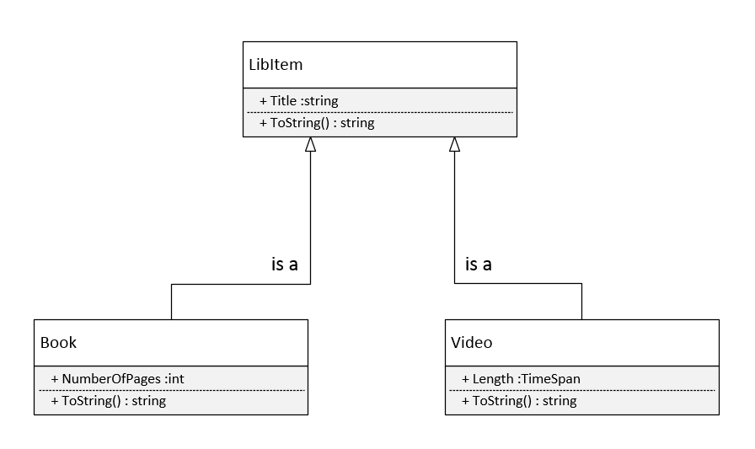
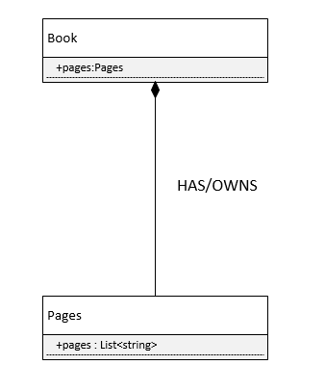
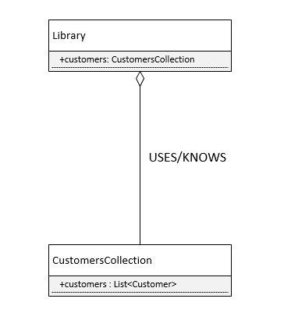
Unified Modeling Language in (very)nutshell
Inheritance
Composition
Aggregation

Slide 4
S.O.L.I.D.
Single Responsibility principle (SRP)
Open/closed principle (OCP)
Liskov substitution principle (LSP)
Interface segregation principle (ISP)
Dependency inversion principle (DIP)

Slide 5
Design patterns types
Creational – designed to abstract instantiation process.
Structural – concerned with how two or more objects are composed into a bigger object.
Behavioral – concerned with algorithms and assigning responsibility between objects.

Slide 6
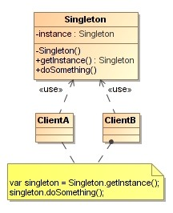
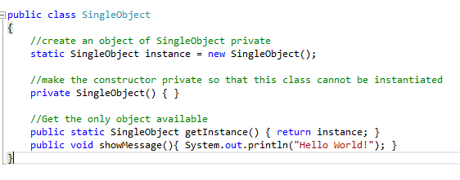
Singleton (creational)
Forces a developer to use only ONE instance of an object for current application life span.
Define
UML

Slide 7
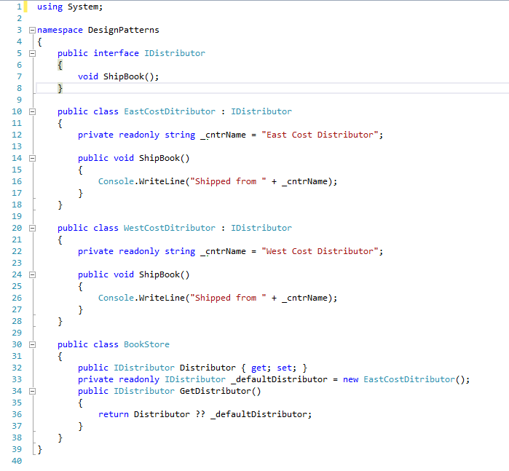
Factory (creational)
Object which acts as creator of other objects implementing same interface

Slide 8
Bridge (structural)
Enables use of different APIs by same type of object
Works like “API injector”

Slide 9
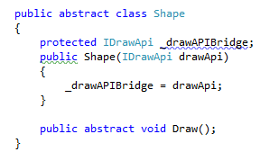

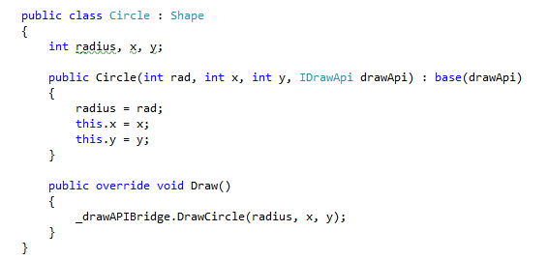
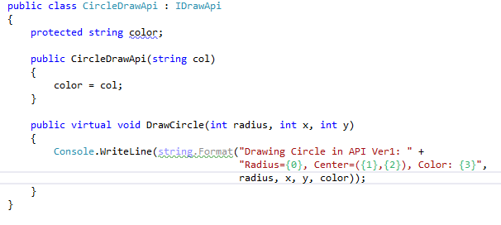
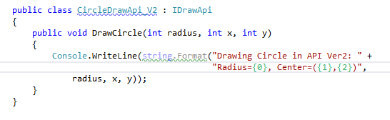
Bridge – practical example

Slide 10
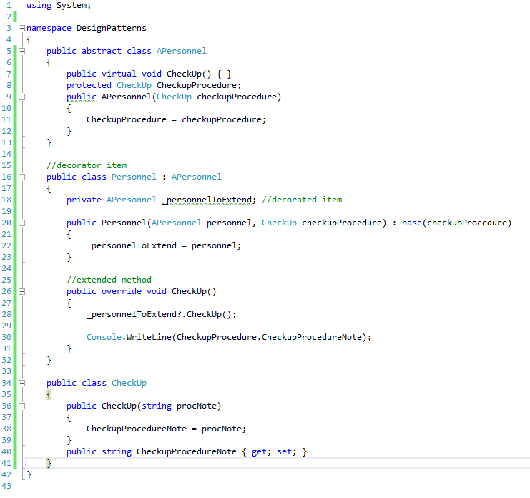
Decorator (structural)
Extends (decorates) an object’s functionality

Slide 11
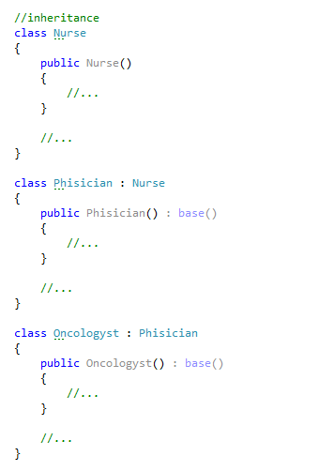
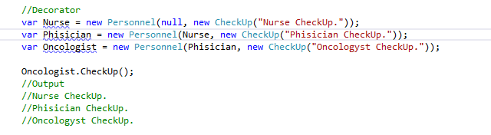
Decorator vs. Inheritance – what’s better?

Slide 12
Visitor (behavioral)
Represent an operation to be performed on different objects without changing the objects

Slide 13
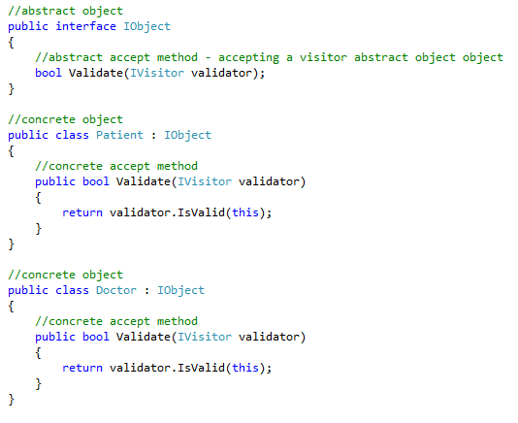
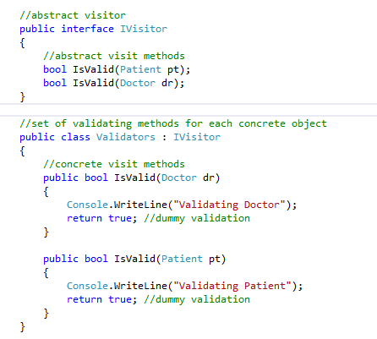
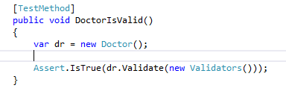
Visitor - example

Slide 14
Q&A

Slide 15
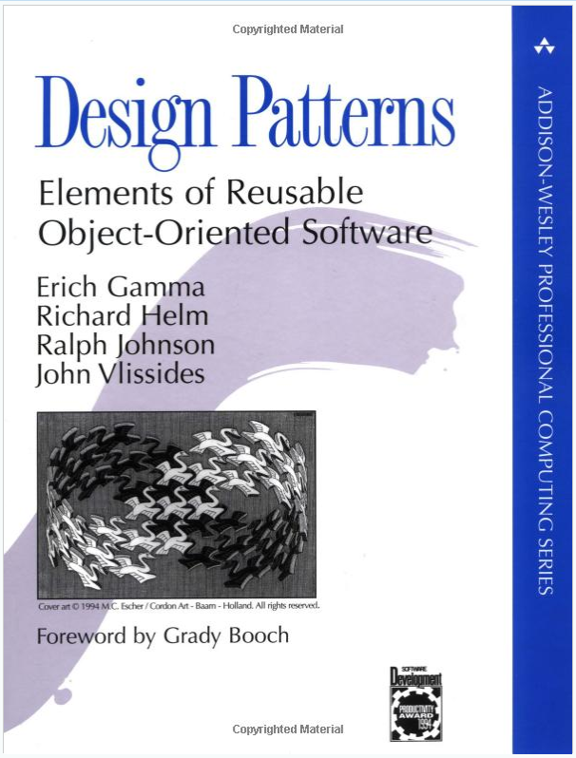
Resources
https://sourcemaking.com/design_patterns
http://www.dofactory.com/net/design-patterns

Slide 16
Exercises

Slide 17
Part1 – Implement Library main engine
Given:
main method which starts Library application
Task:
Using Singleton pattern make sure the system will always run only one instance of library

Slide 18
Part2 - Implement part of a library registration system
Given:
Book class extending LibItem abstract class
Video class extending LibItem abstract class
Customer class extending Person abstract class
Task:
Using Bridge pattern implement Registration class that adds new book, video or customer to the library.

Slide 19
Part3 - Implement part of a library tracking system
Given:
Book class extending LibItem class
Video class extending LibItem class
Task:
Using Decorator pattern implement BookBorrowable class that enables to borrow a book from the library.

